Slide 1
Customer Click Through Rate Simulation
Presented by Siyuan Zhao, Xiaolei Shao

Slide 2
Main Points
Today’s
Discussion
Introduction
Hypotheses
Variables & Distributions
Model
Summary

Slide 3
Introduction
Design a program that leverages Monte Carlo simulation to simulate the click-through rate of mobile apps in the whole Chicago city

Slide 4
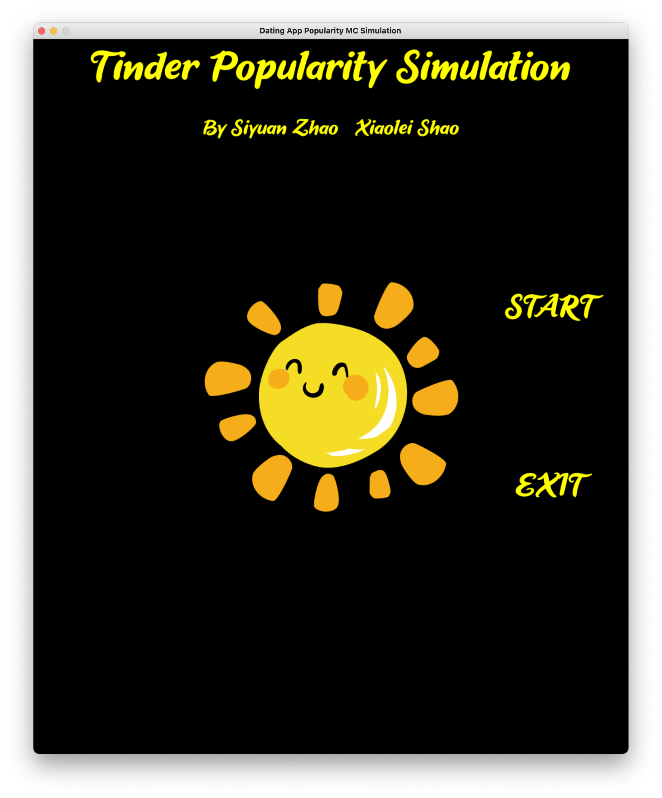
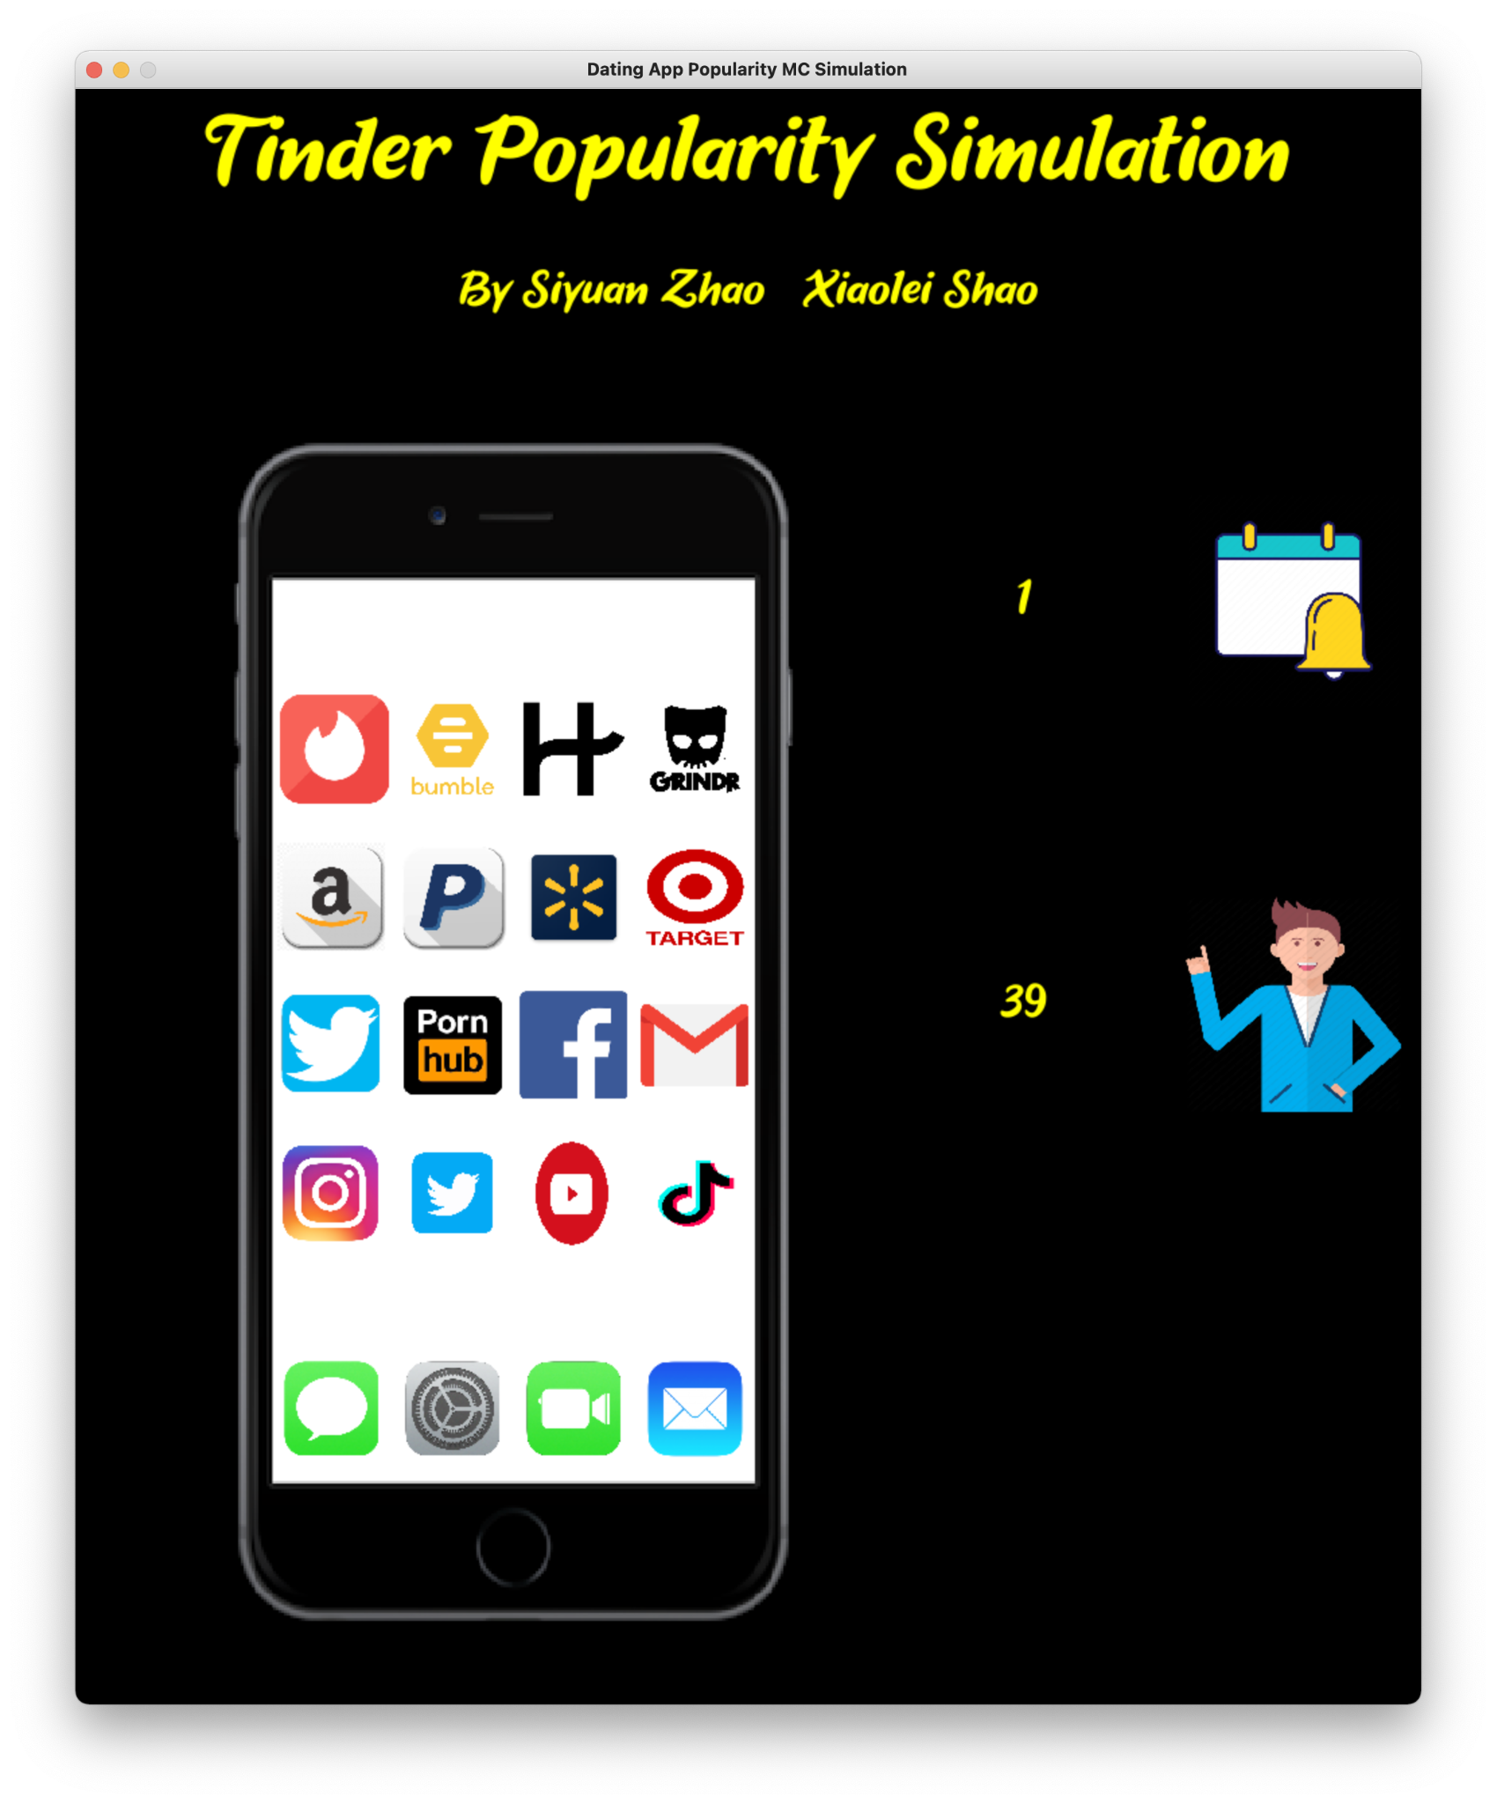
Demo

Slide 5
Hypothesis
H1:
H2:
The daily click-through rate of Tinder app is less than 10%.
The Weather affects consumers’ choices.

Slide 6
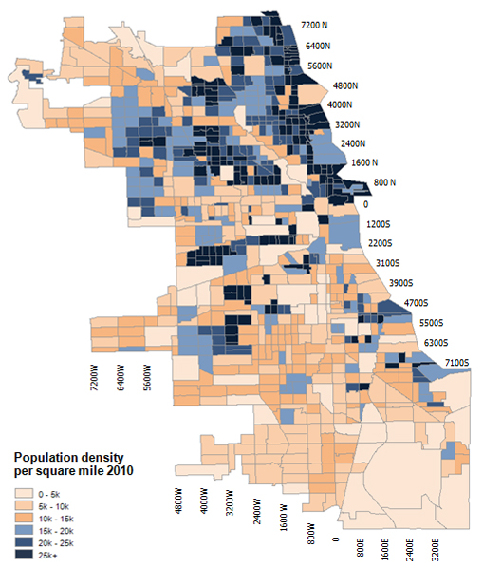
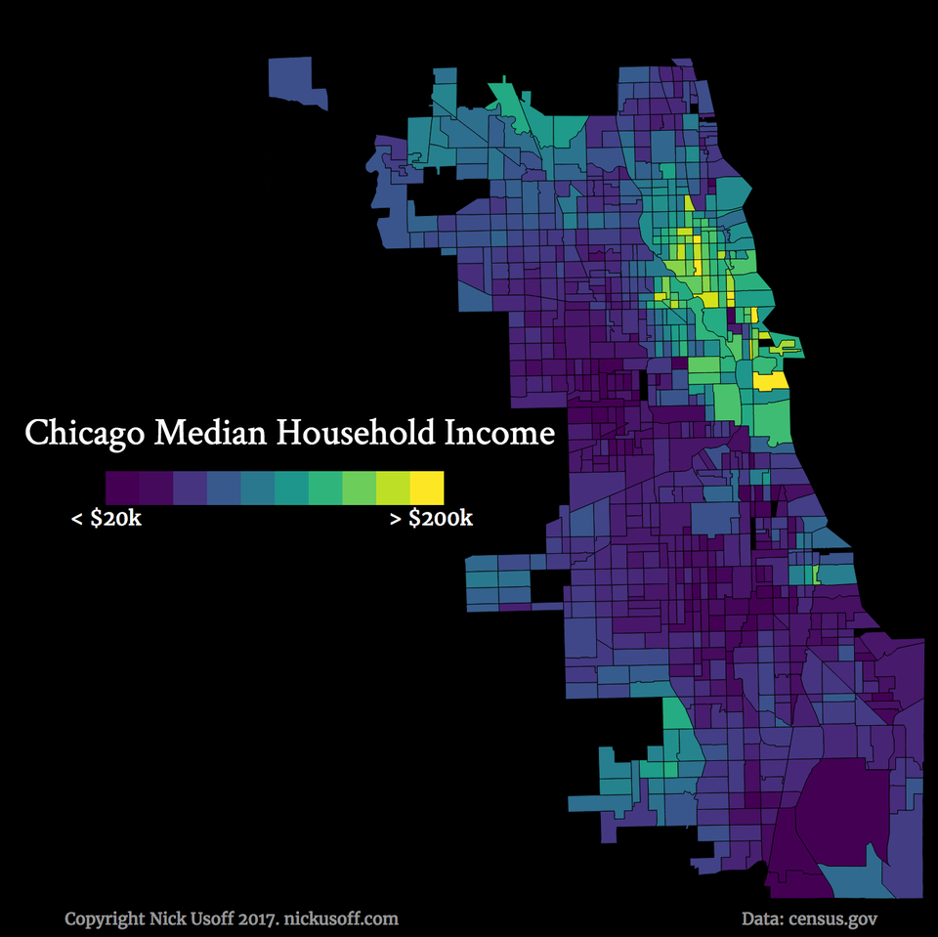
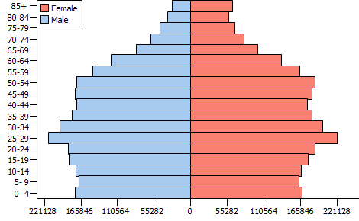
Description
Variables & Distributions
Population density
Household income
Age
User preference
Variables
Weather
App preference
User income
Assumption
Reference:
http://afterburnham.com/settlements/3-5-06-city-of-chicago-population-density-circa-2010/
http://proximityone.com/metros/pp17031_2010_001.htm
https://www.reddit.com/r/dataisbeautiful/comments/5qcslz/income_distribution_in_chicago_oc/

Slide 7
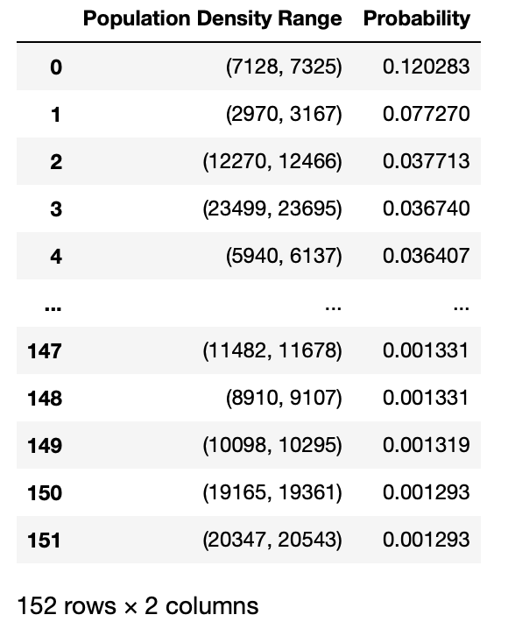
The Distribution of Population

Slide 8
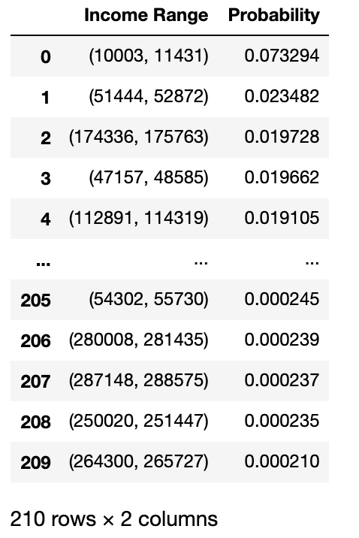
The Distribution of Household Income

Slide 9
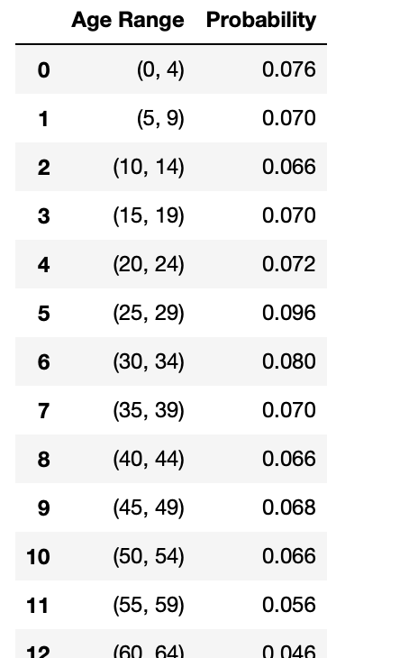
The Distribution of Age

Slide 10
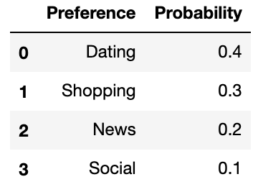
The Distribution of User Preference

Slide 11
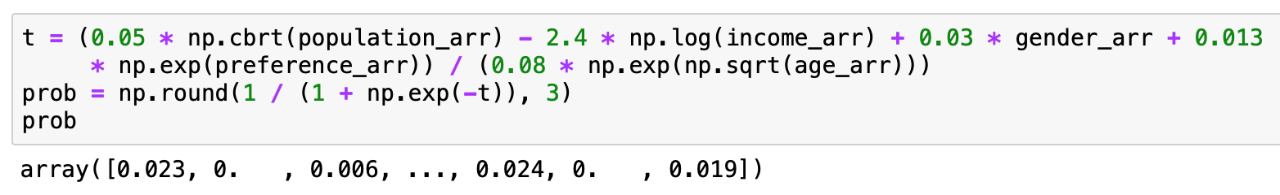
Model

Slide 12
Summary
H1: The daily click-through rate of Tinder app is less than 10%. TRUE

Slide 13
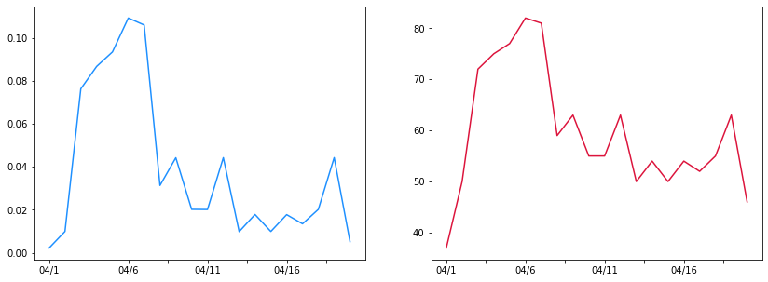
Summary
H2: Weather affects customers’ choices TRUE
Model:
Collected data since April 1 and run the simulation

Slide 14
References
Free Resources
http://proximityone.com/metros/pp17031_2010_001.htm
http://afterburnham.com/settlements/3-5-06-city-of-chicago-population-density-circa-2010/
https://www.reddit.com/r/dataisbeautiful/comments/5qcslz/income_distribution_in_chicago_oc/

Slide 15
Thank you!

